Slide 1
UMAP vs PaCMAP
A comparison of dimensionality reduction algorithms’ abilities to preserve local and global data structures
Linnéa Gustafsson, linneag2@kth.se
DD2470 Advanced Topics in Visualization and Computer Graphics
KTH Royal Institute of Technology

Slide 2
Before we begin, a quick recap:

Slide 3
Dimensionality reduction (DR)
High-dimensional space → low-dimensional space (in visualization, 2D/3D)
“The goal of dimension reduction for data visualization is to take high dimensional data and project it down to 2 or 3 dimensions so that humans can understand its structure.” [1]
[1] Dimension Reduction for Data Visualization, Duke Course Notes, Cynthia Rudin

Slide 4
Now, let’s begin the presentation:

Slide 5
Research question

Slide 6
I. Research question
The question
How does the performance of UMAP compare to PaCMAP in preserving local and global structures?
The evaluation will be based on KNN accuracy and SVM accuracy for local structure preservation,
and random triplet accuracy and centroid triplet accuracy for global structure preservation.

Slide 7
I. Research question
The question
How does the performance of UMAP compare to PaCMAP in preserving local and global structures?
The evaluation will be based on KNN accuracy and SVM accuracy for local structure preservation,
and random triplet accuracy and centroid triplet accuracy for global structure preservation.
The question is based on “the PaCMAP paper”: Understanding how dimension reduction tools work: an empirical approach to deciphering t-SNE, UMAP, TriMAP, and PaCMAP for data visualization [1]
[1] Wang, Y., Huang, H., Rudin, C., & Shaposhnik, Y. (2021). Understanding how dimension reduction tools work: an empirical approach to deciphering t-SNE, UMAP, TriMAP, and PaCMAP for data visualization. The Journal of Machine Learning Research, 22(1), 9129-9201.

Slide 8
I. Research question
The question
How does the performance of UMAP compare to PaCMAP in preserving local and global structures?
The evaluation will be based on KNN accuracy and SVM accuracy for local structure preservation,
and random triplet accuracy and centroid triplet accuracy for global structure preservation.

Slide 9
I. Research question
Preservation of local and global structures
There is no strict definition of local or global structure preservation
One way to think about it:
Local structure-preservation methods
preserve neighborhoods, so that neighbors in the high-dimensional space are still neighbors in low-dimensional space
Global structure-preservation methods
preserve overall relative placement of large clusters
Dimension Reduction for Data Visualization, Duke Course Notes, Cynthia Rudin

Slide 10
I. Research question
Preservation claims of algorithms
UMAP
Aims to preserve local structure
Preserves more of the global structure than other algorithms (e.g., t-SNE) [1]
PaCMAP
Aims to preserve both local and global structure [2]
[1] McInnes, L, Healy, J, Melville, J, UMAP: Uniform Manifold Approximation and Projection for Dimension Reduction, ArXiv e-prints 1802.03426, 2018 [2] Wang, Y., Huang, H., Rudin, C., & Shaposhnik, Y. (2021). Understanding how dimension reduction tools work: an empirical approach to deciphering t-SNE, UMAP, TriMAP, and PaCMAP for data visualization. The Journal of Machine Learning Research, 22(1), 9129-9201.

Slide 11
I. Research question
The question
How does the performance of UMAP compare to PaCMAP in preserving local and global structures?
The evaluation will be based on KNN accuracy and SVM accuracy for local structure preservation,
and random triplet accuracy and centroid triplet accuracy for global structure preservation.

Slide 12
I. Research question
The question
How does the performance of UMAP compare to PaCMAP in preserving local and global structures?
The evaluation will be based on KNN accuracy and SVM accuracy for local structure preservation,
and random triplet accuracy and centroid triplet accuracy for global structure preservation.

Slide 13
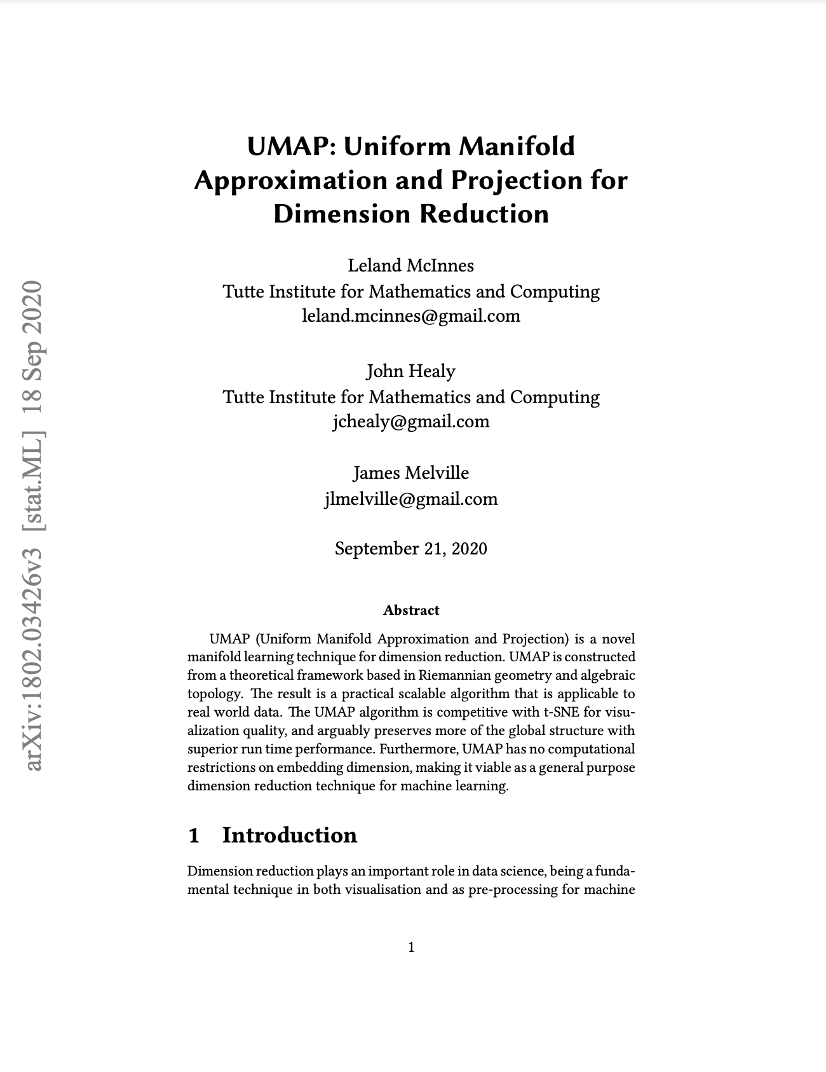
I. Research question
UMAP
UMAP: Uniform Manifold Approximation and Projection
McInnes, L, Healy, J, Melville, J, UMAP: Uniform Manifold Approximation and Projection for Dimension Reduction, ArXiv e-prints 1802.03426, 2018

Slide 14
I. Research question
UMAP
Algorithm: k-neighbour based graph learning algorithm
Step 1: Graph construction (data → graph)
Construct local weighted graph based on distance between points (closer ⇔) larger weight
Patch graphs together ⇒ Fuzzy topological representation of the data
Step 2: Graph layout (graph → lower dimension)
Cost function is minimized
McInnes, L, Healy, J, Melville, J, UMAP: Uniform Manifold Approximation and Projection for Dimension Reduction, ArXiv e-prints 1802.03426, 2018

Slide 15
I. Research question
The question
How does the performance of UMAP compare to PaCMAP in preserving local and global structures?
The evaluation will be based on KNN accuracy and SVM accuracy for local structure preservation,
and random triplet accuracy and centroid triplet accuracy for global structure preservation.

Slide 16
I. Research question
The question
How does the performance of UMAP compare to PaCMAP in preserving local and global structures?
The evaluation will be based on KNN accuracy and SVM accuracy for local structure preservation,
and random triplet accuracy and centroid triplet accuracy for global structure preservation.

Slide 17
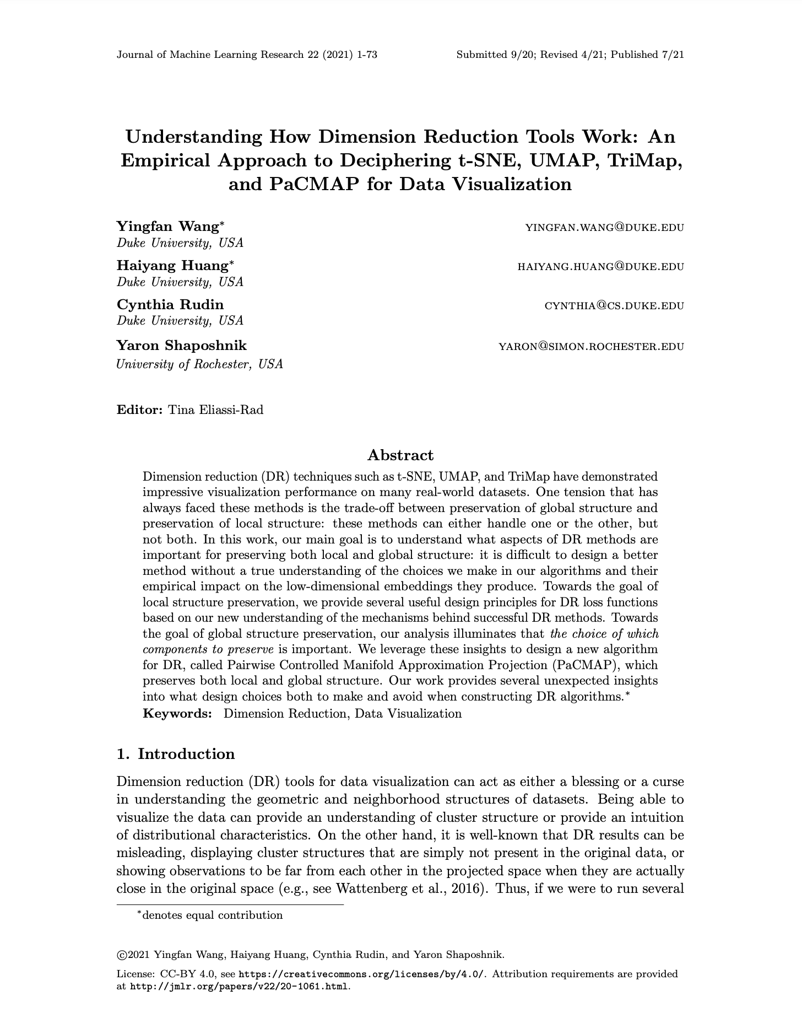
I. Research question
PaCMAP
PaCMAP: Pairwise Controlled Manifold Approximation Projection
Wang, Y., Huang, H., Rudin, C., & Shaposhnik, Y. (2021). Understanding how dimension reduction tools work: an empirical approach to deciphering t-SNE, UMAP, TriMAP, and PaCMAP for data visualization. The Journal of Machine Learning Research, 22(1), 9129-9201.

Slide 18
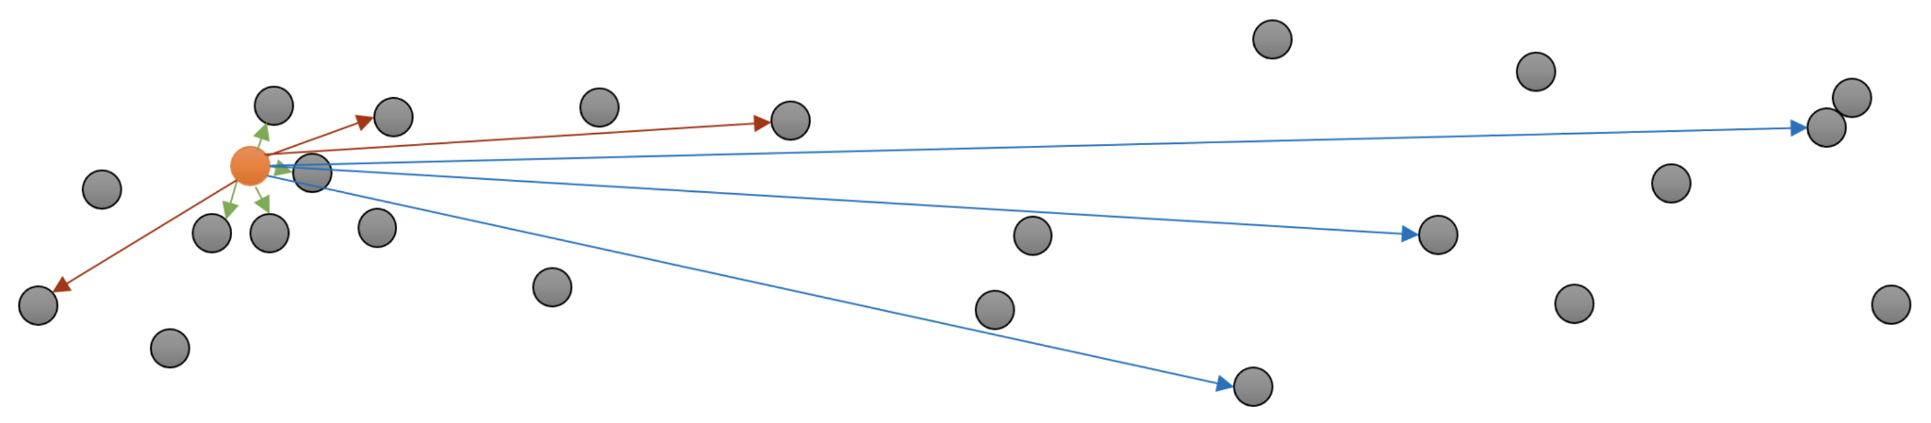
I. Research question
PaCMAP
Algorithm
Step 1: Global structure optimization Preserve the red point pairs
Step 2: Global and local optimization Preserve the red and green (and blue) point pairs
Step 3: Refinement of local structure Preserve the green and blue point pairs
Green: neighbors; Red: mid-near points; Blue: further points.
Dimension Reduction for Data Visualization, Duke Course Notes, Cynthia Rudin

Slide 19
I. Research question
The question
How does the performance of UMAP compare to PaCMAP in preserving local and global structures?
The evaluation will be based on KNN accuracy and SVM accuracy for local structure preservation,
and random triplet accuracy and centroid triplet accuracy for global structure preservation.

Slide 20
I. Research question
The question
How does the performance of UMAP compare to PaCMAP in preserving local and global structures?
The evaluation will be based on KNN accuracy and SVM accuracy for local structure preservation,
and random triplet accuracy and centroid triplet accuracy for global structure preservation.

Slide 21
I. Research question
Evaluation: Local structures
KNN accuracy
Accuracy of KNN classifier applied to reduced dataset
SVM accuracy
Accuracy of SVM classifier applied to reduced dataset
Notes:
“The intuition behind this method is that labels tend to be similar in small neighborhoods and therefore the classification accuracy based on neighborhoods would remain close to that in the high-dimensional space.” [1]
“Similarly to KNN, the SVM accuracy measures the cohesiveness of neighborhoods, but this is done in a potentially more flexible manner that is less impacted by the density of the data.” [1]
[1] Wang, Y., Huang, H., Rudin, C., & Shaposhnik, Y. (2021). Understanding how dimension reduction tools work: an empirical approach to deciphering t-SNE, UMAP, TriMAP, and PaCMAP for data visualization. The Journal of Machine Learning Research, 22(1), 9129-9201.

Slide 22
I. Research question
Evaluation: Global structures
Random triplet accuracy
Percentage of triplets whose relative distance in the high- and low-dimensional spaces maintain their relative order
Centroid triplet accuracy
Percentage of preserved centroid triplets
Notes:
Random: Random sample of triplets
Triplet: Triplet of (randomly sampled) points
Centroid: Centroid of each class in the high- and low-dimensional spaces
Triplet: Triplet of centroids, using the relative distances between centroids in the high-dimensional space

Slide 23
II. Implementation

Slide 24
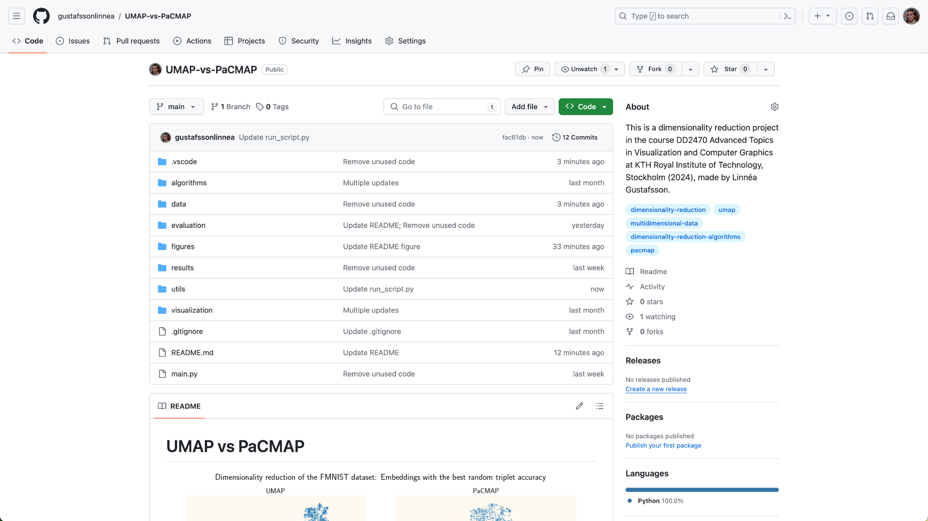
II. Implementation
Code
Implemented in Python
UMAP [1]
PaCMAP [2]
Data loading & two datasets
Hyperparameter tuning
Visualization
Evaluation [3]
Etc.
See details in GitHub repository (QR code in end slide): https://github.com/gustafssonlinnea/UMAP-vs-PaCMAP
[1] https://umap-learn.readthedocs.io/en/latest/ [2] https://pypi.org/project/pacmap/ [3] https://github.com/YingfanWang/PaCMAP/blob/master/evaluation/evaluation.py

Slide 25
II. Implementation
Datasets
8 different datasets of different dimensionalities, sizes and number of classes
Iris [1]
Digits [2]
MNIST [3]
FMNIST [4]
CIFAR-10 [5]
CIFAR-100 [5]
Spiral3D created by me
Circle2D created by me
2D → 2D
[1] https://scikit-learn.org/stable/auto_examples/datasets/plot_iris_dataset.html [2] https://scikit-learn.org/stable/auto_examples/datasets/plot_digits_last_image.html [3] LeCun, Y., Bottou, L., Bengio, Y., & Haffner, P. (1998). Gradient-based learning applied to document recognition. Proceedings of the IEEE, 86(11), 2278-2324. [4] Xiao, H., Rasul, K., & Vollgraf, R. (2017). Fashion-mnist: a novel image dataset for benchmarking machine learning algorithms. arXiv preprint arXiv:1708.07747. [5] Krizhevsky, A., & Hinton, G. (2009). Learning multiple layers of features from tiny images.

Slide 26
II. Implementation
Hyperparameter tuning
Focus on trade-off between local and global structure preservation:
UMAP
n, the number of neighbors to consider when approximating the local metric
PaCMAP
n, the number of neighbors considered in the kNN graph The green point pairs
[1]
n ∈ {5, 10, 20, 50, 100}
[1] Dimension Reduction for Data Visualization, Duke Course Notes, Cynthia Rudin
Notes:
UMAP
min-dist, the desired separation between close points in the embedding space
Aesthetic parameter to help avoid overplotting
PaCMAP
MN-ratio, the ratio of the number of mid-near pairs to the number of neighbors, n-MN = n * MN_ratio
FP-ratio, the ratio of the number of further pairs to the number of neighbors, n-FP = n * FP-ratio
“PaCMAP […] seems to be fairly robust in its hyperparameter choices” [1]
“[…] it shouldn’t need tuning of the parameters” [2]
[1] Wang, Y., Huang, H., Rudin, C., & Shaposhnik, Y. (2021). Understanding how dimension reduction tools work: an empirical approach to deciphering t-SNE, UMAP, TriMAP, and PaCMAP for data visualization. The Journal of Machine Learning Research, 22(1), 9129-9201. [2] Dimension Reduction for Data Visualization, Duke Course Notes, Cynthia Rudin

Slide 27
II. Implementation
Evaluation
The final results = the best results of the hyperparameter search
(see which n in the visualizations)

Slide 28
III. Evaluation

Slide 29
III. Evaluation
Local metrics: KNN and SVM accuracy
Dataset | Dimensions | Size | Classes | KNN: UMAP | KNN: PaCMAP | SVM: UMAP | SVM: PaCMAP
Iris | 4 | 150 | 3 | 0.980 | 0.973 | 0.973 | 0.967
Digits | 64 | 1 797 | 10 | 0.991 | 0.992 | 0.982 | 0.984
MNIST | 784 | 70 000 | 10 | 0.969 | 0.976 | 0.967 | 0.973
FMNIST | 784 | 70 000 | 10 | 0.803 | 0.773 | 0.742 | 0.749
CIFAR-10 | 3 072 | 60 000 | 10 | 0.256 | 0.235 | 0.253 | 0.254
CIFAR-100 | 3 072 | 60 000 | 100 | 0.088 | 0.068 | 0.076 | 0.074
Spiral3D | 3 | 400 | 80 | 0.808 | 0.818 | 0.648 | 0.638
Circle2D | 2 | 100 | 20 | 0.830 | 0.800 | 0.800 | 0.770
Notes:
Iris
UMAP Neighbors PaCMAP Neighbors
KNN accuracy 0.98 10 0.973333 5
SVM accuracy 0.973333 20 0.966667 10
Centroid triplet accuracy 1.0 5 1.0 5
Random triplet accuracy 0.905333 20 0.926667 20
KNN neighbors 15 3
Digits
UMAP Neighbors PaCMAP Neighbors
KNN accuracy 0.99054 5 0.991653 5
SVM accuracy 0.981645 5 0.983872 5
Centroid triplet accuracy 0.762626 100 0.785859 10
Random triplet accuracy 0.642515 50 0.682693 5
KNN neighbors 5 5
CIFAR-10
UMAP Neighbors PaCMAP Neighbors
KNN accuracy 0.256367 5 0.235417 10
SVM accuracy 0.25305 5 0.253683 10
Centroid triplet accuracy 0.946465 10 0.937374 100
Random triplet accuracy 0.43156 5 0.43151 5
KNN neighbors 30 30
CIFAR-100
UMAP Neighbors PaCMAP Neighbors
KNN accuracy 0.088317 5 0.068283 5
SVM accuracy 0.0755 5 0.0743 5
Centroid triplet accuracy 0.855152 50 0.851002 5
Random triplet accuracy 0.439667 10 0.44006 5
KNN neighbors 25 30
FMNIST
UMAP Neighbors PaCMAP Neighbors
KNN accuracy 0.803171 5 0.772557 5
SVM accuracy 0.742329 10 0.748557 10
Centroid triplet accuracy 0.870707 100 0.858586 5
Random triplet accuracy 0.542523 50 0.539554 5
KNN neighbors 15 30
MNIST
UMAP Neighbors PaCMAP Neighbors
KNN accuracy 0.969414 10 0.975686 5
SVM accuracy 0.9674 10 0.972529 5
Centroid triplet accuracy 0.79798 10 0.69596 5
Random triplet accuracy 0.587523 100 0.5912 10
KNN neighbors 10 15
Spiral3D
UMAP Neighbors PaCMAP Neighbors
KNN accuracy 0.8075 10 0.8175 5
SVM accuracy 0.6475 10 0.6375 5
Centroid triplet accuracy 0.605062 100 0.682449 100
Random triplet accuracy 0.6885 100 0.6995 50
KNN neighbors 1 3
Circle2D
UMAP Neighbors PaCMAP Neighbors
KNN accuracy 0.83 50 0.8 10
SVM accuracy 0.8 5 0.77 10
Centroid triplet accuracy 0.925647 20 0.96831 10
Random triplet accuracy 0.95 20 0.99 5
KNN neighbors 5 1

Slide 30
III. Evaluation
Global metrics: Random & centroid triplet accuracy
Dataset | Dimensions | Size | Classes | Random: UMAP | Random: PaCMAP | Centroid: UMAP | Centroid: PaCMAP
Iris | 4 | 150 | 3 | 0.905 | 0.927 | 1.000 | 1.000
Digits | 64 | 1 797 | 10 | 0.643 | 0.683 | 0.763 | 0.786
MNIST | 784 | 70 000 | 10 | 0.588 | 0.591 | 0.798 | 0.696
FMNIST | 784 | 70 000 | 10 | 0.543 | 0.540 | 0.871 | 0.859
CIFAR-10 | 3 072 | 60 000 | 10 | 0.432 | 0.432 | 0.946 | 0.937
CIFAR-100 | 3 072 | 60 000 | 100 | 0.440 | 0.440 | 0.855 | 0.851
Spiral3D | 3 | 400 | 80 | 0.689 | 0.700 | 0.605 | 0.682
Circle2D | 2 | 100 | 20 | 0.950 | 0.990 | 0.926 | 0.968

Slide 31
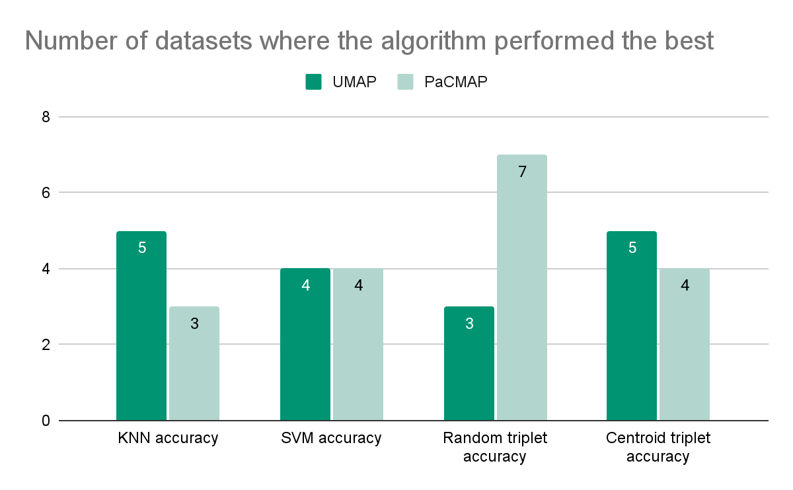
III. Evaluation
Comparison of results
For 3 of 4 metrics they perform about equally well,
while for random triplet accuracy, PaCMAP is remarkably better.
Note: The differences in accuracy are often quite small.

Slide 32
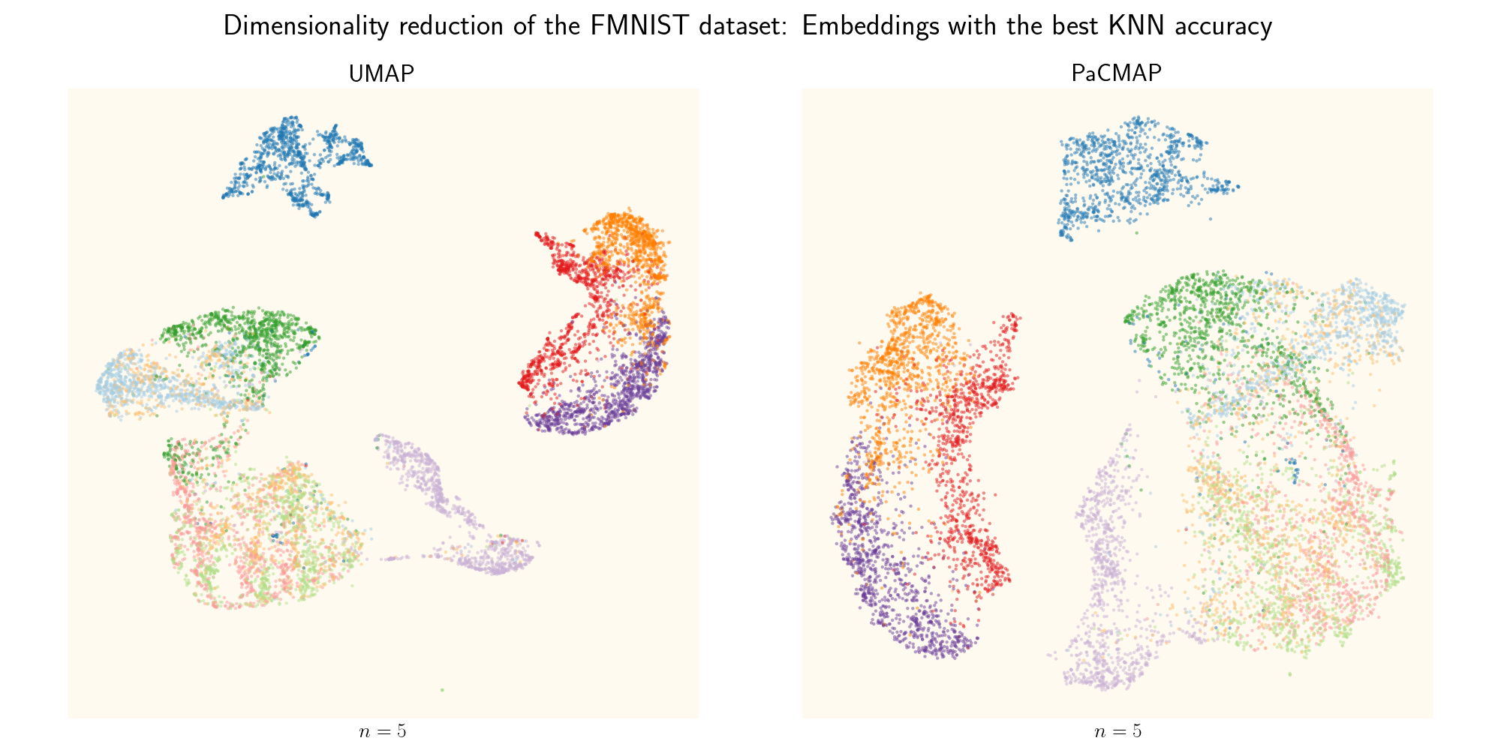
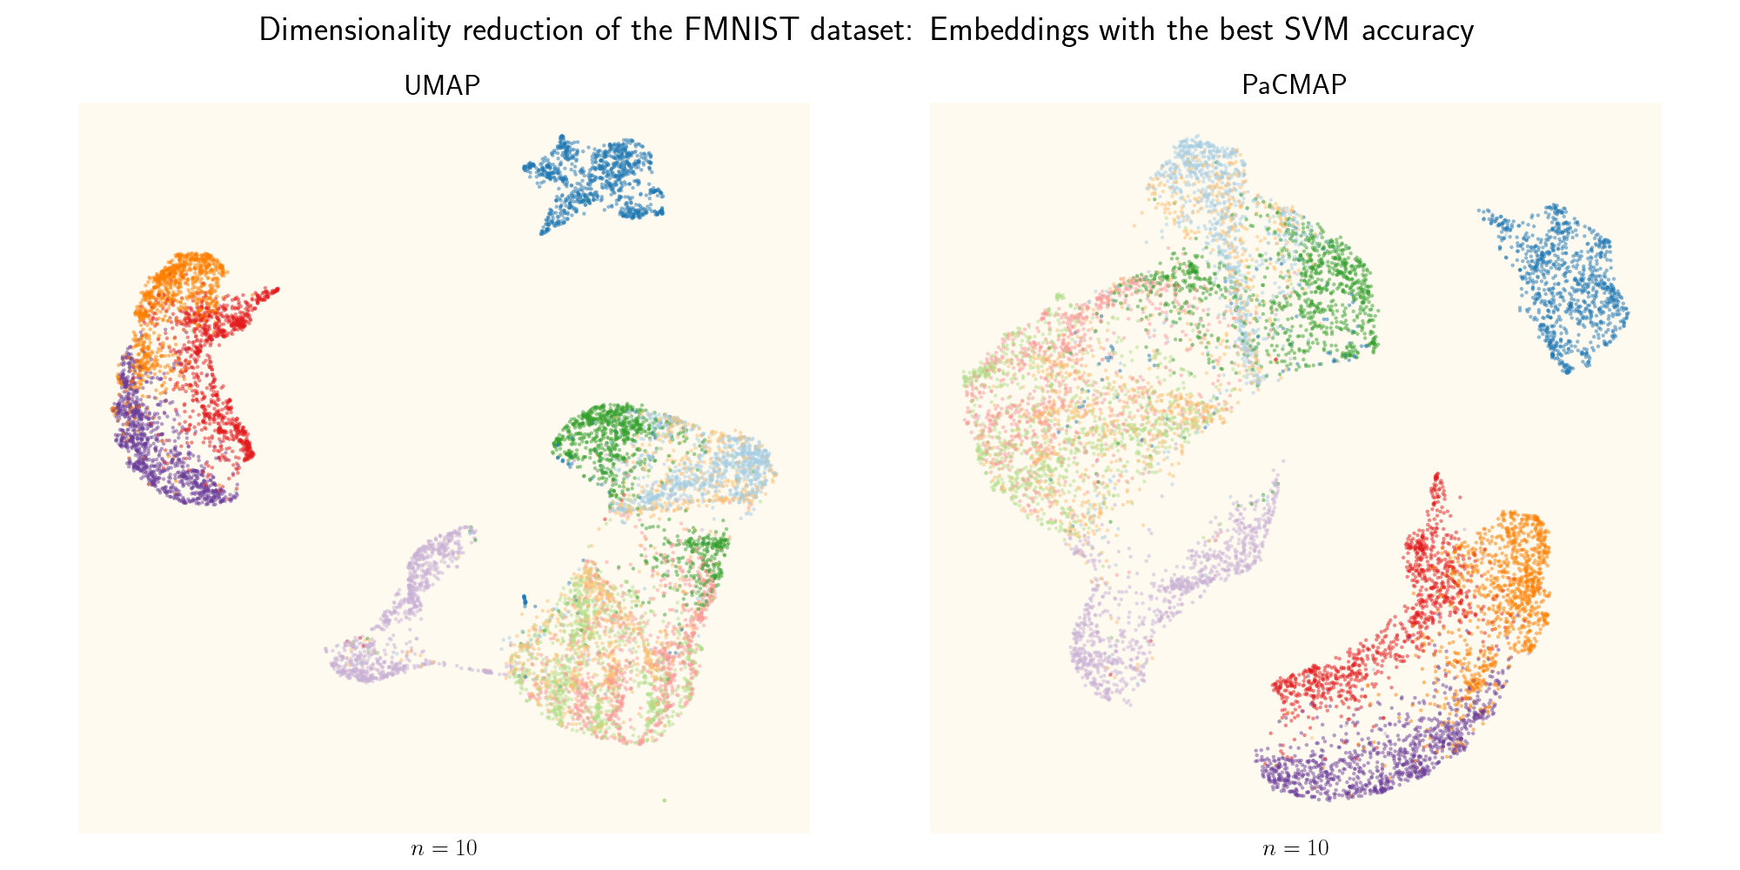
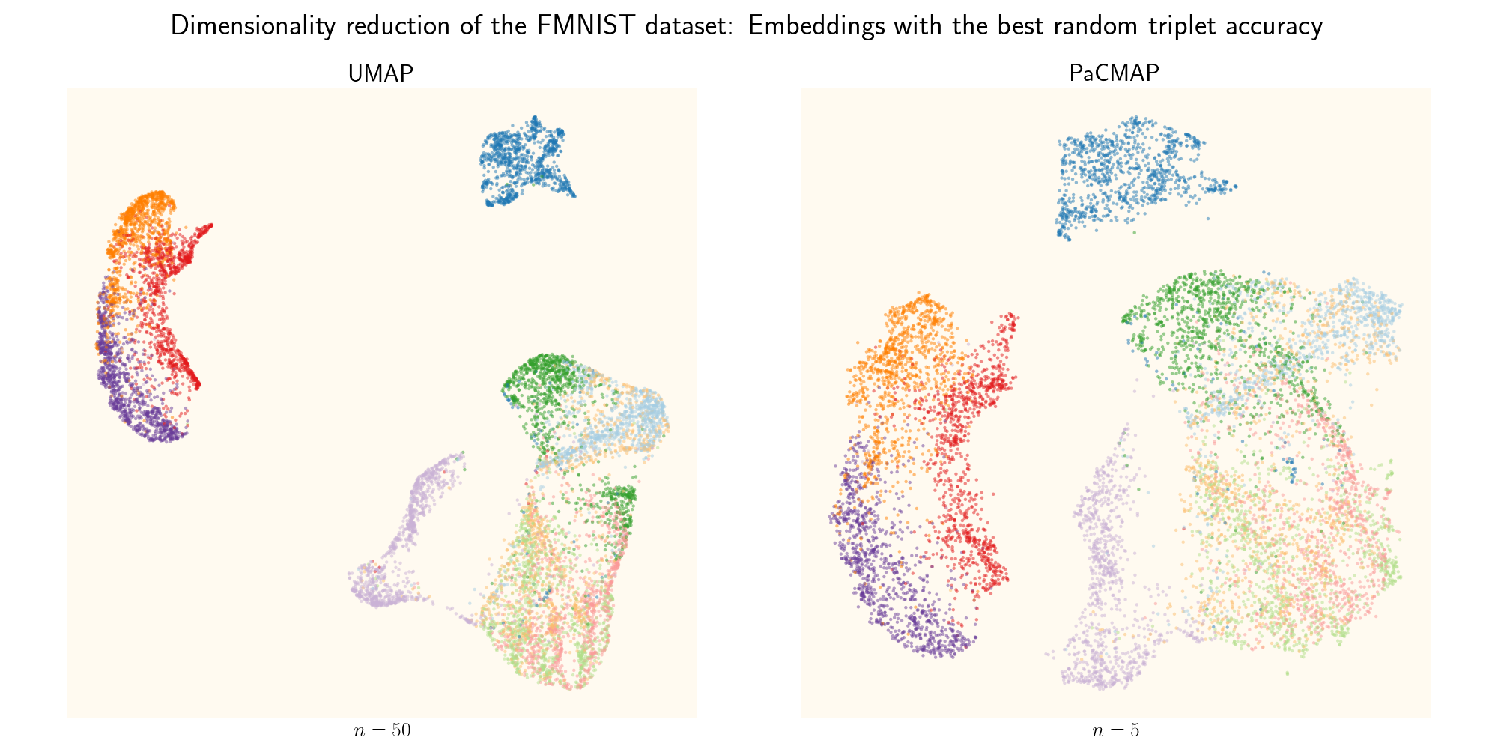
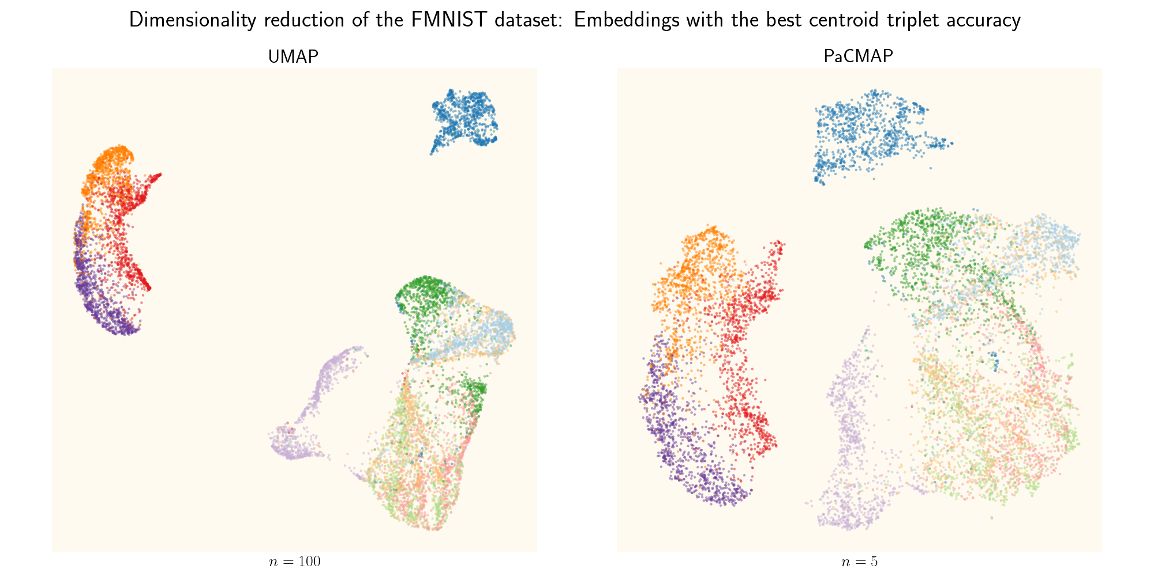
III. Evaluation
Visualization examples: FMNIST dataset

Slide 33
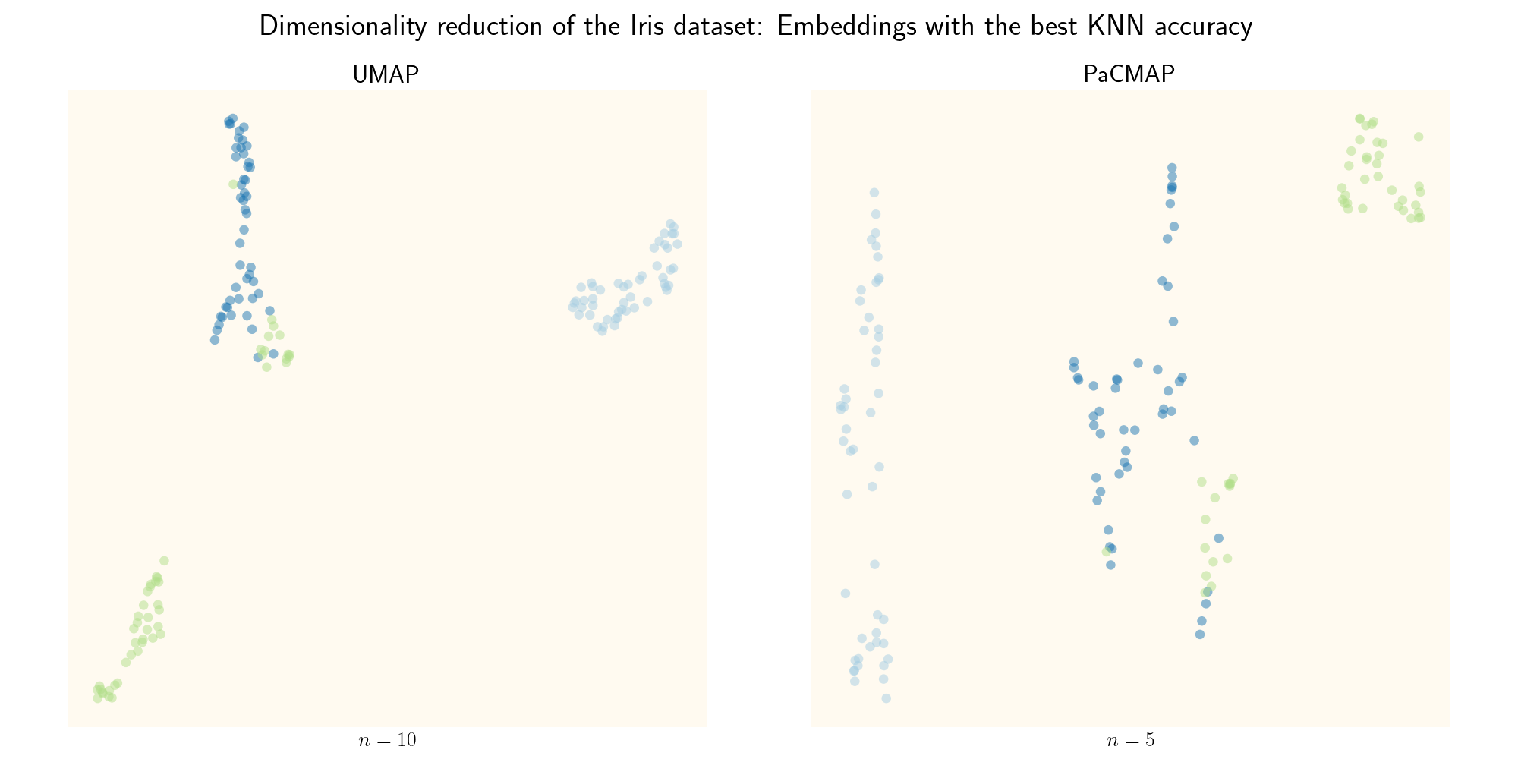
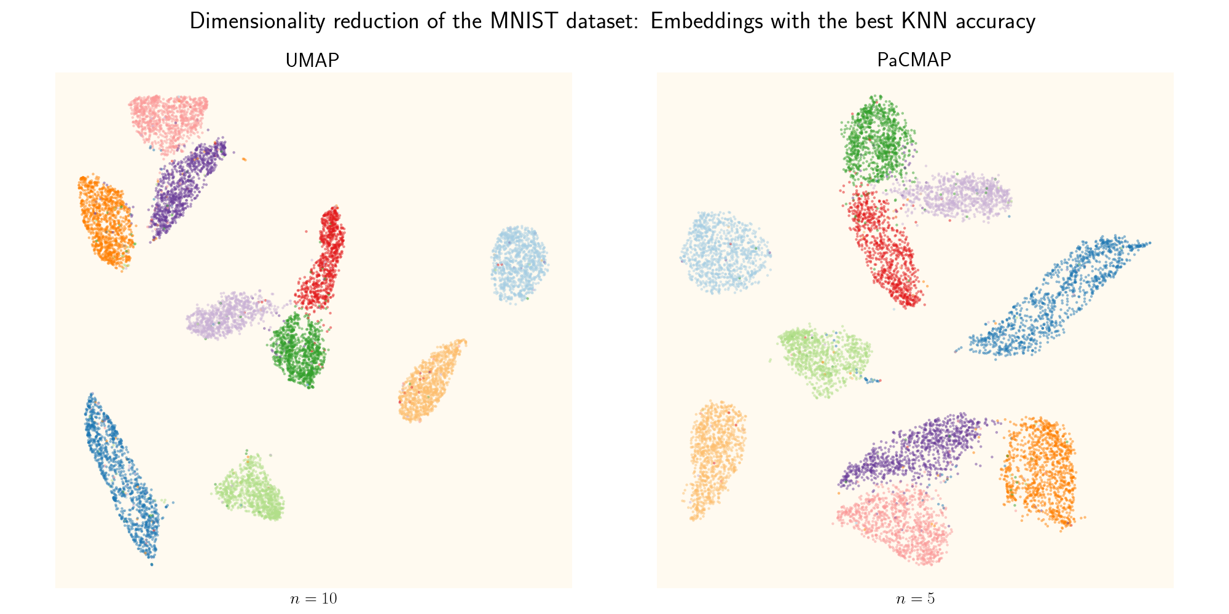

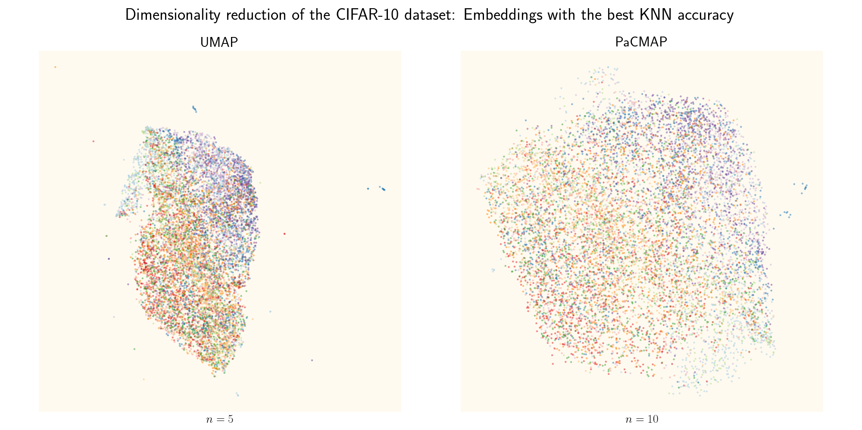
III. Evaluation
Visualization examples: KNN accuracy

Slide 34
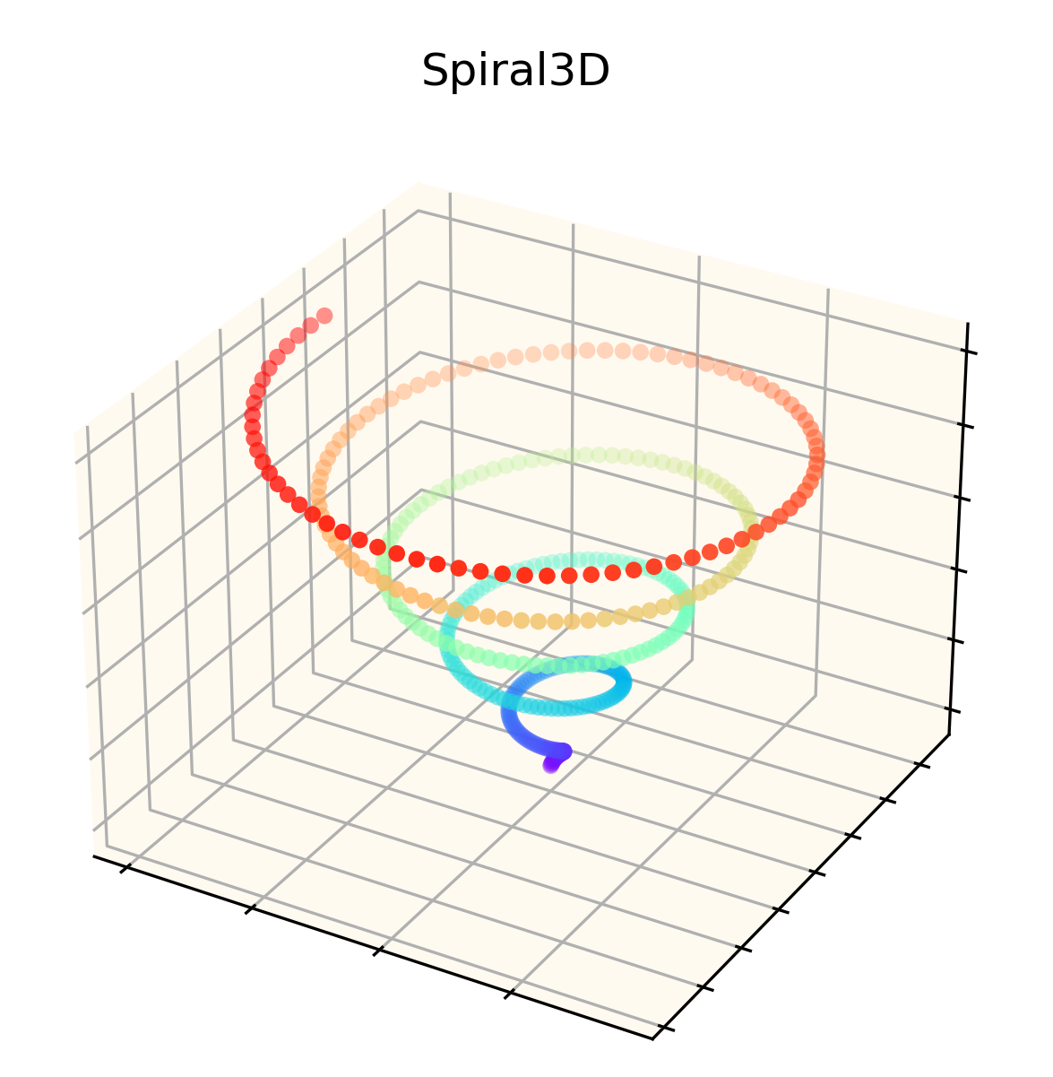
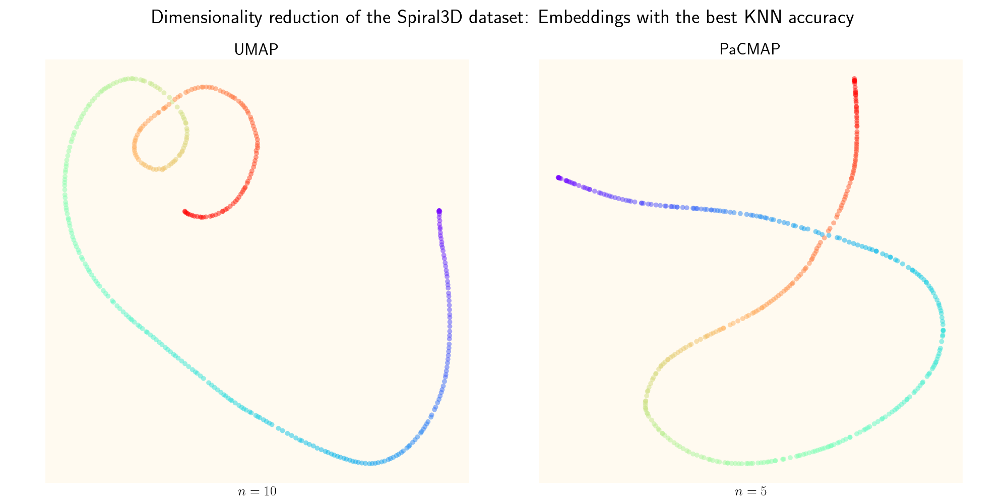
III. Evaluation
Spiral3D dataset: Local preservation
Same plot for SVM accuracy
KNN accuracy: 0.808
SVM accuracy: 0.648
KNN accuracy: 0.818
SVM accuracy: 0.638

Slide 35
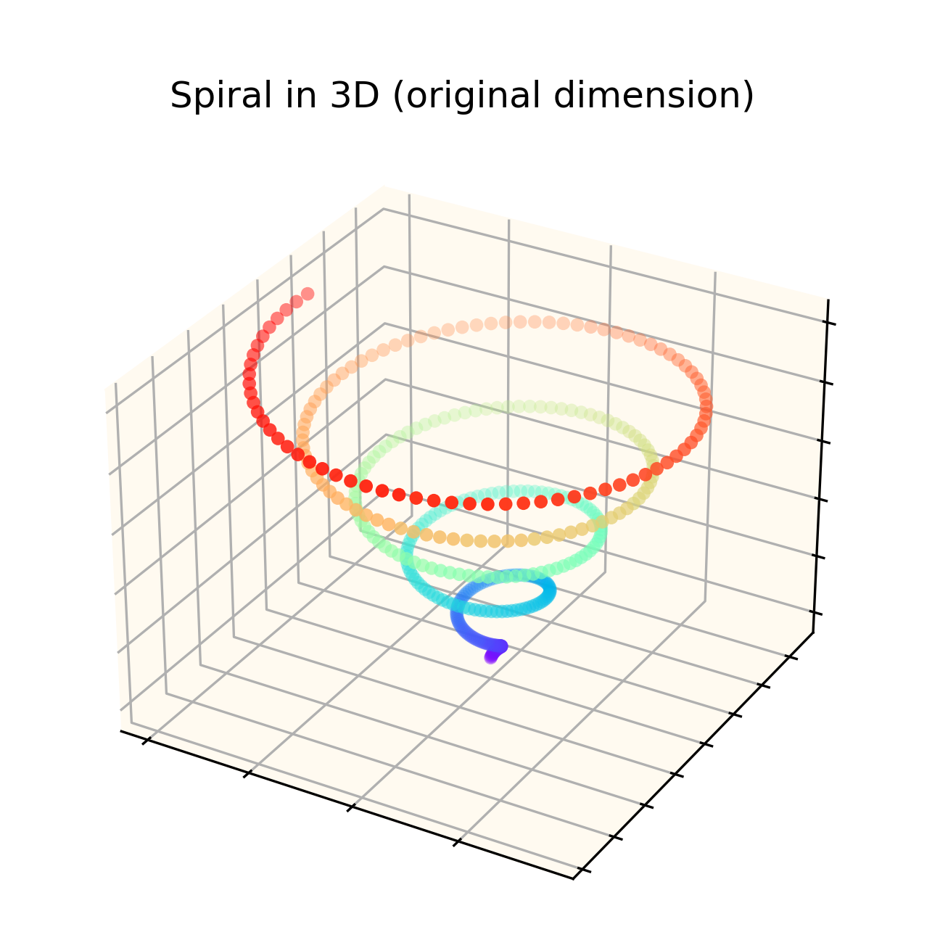
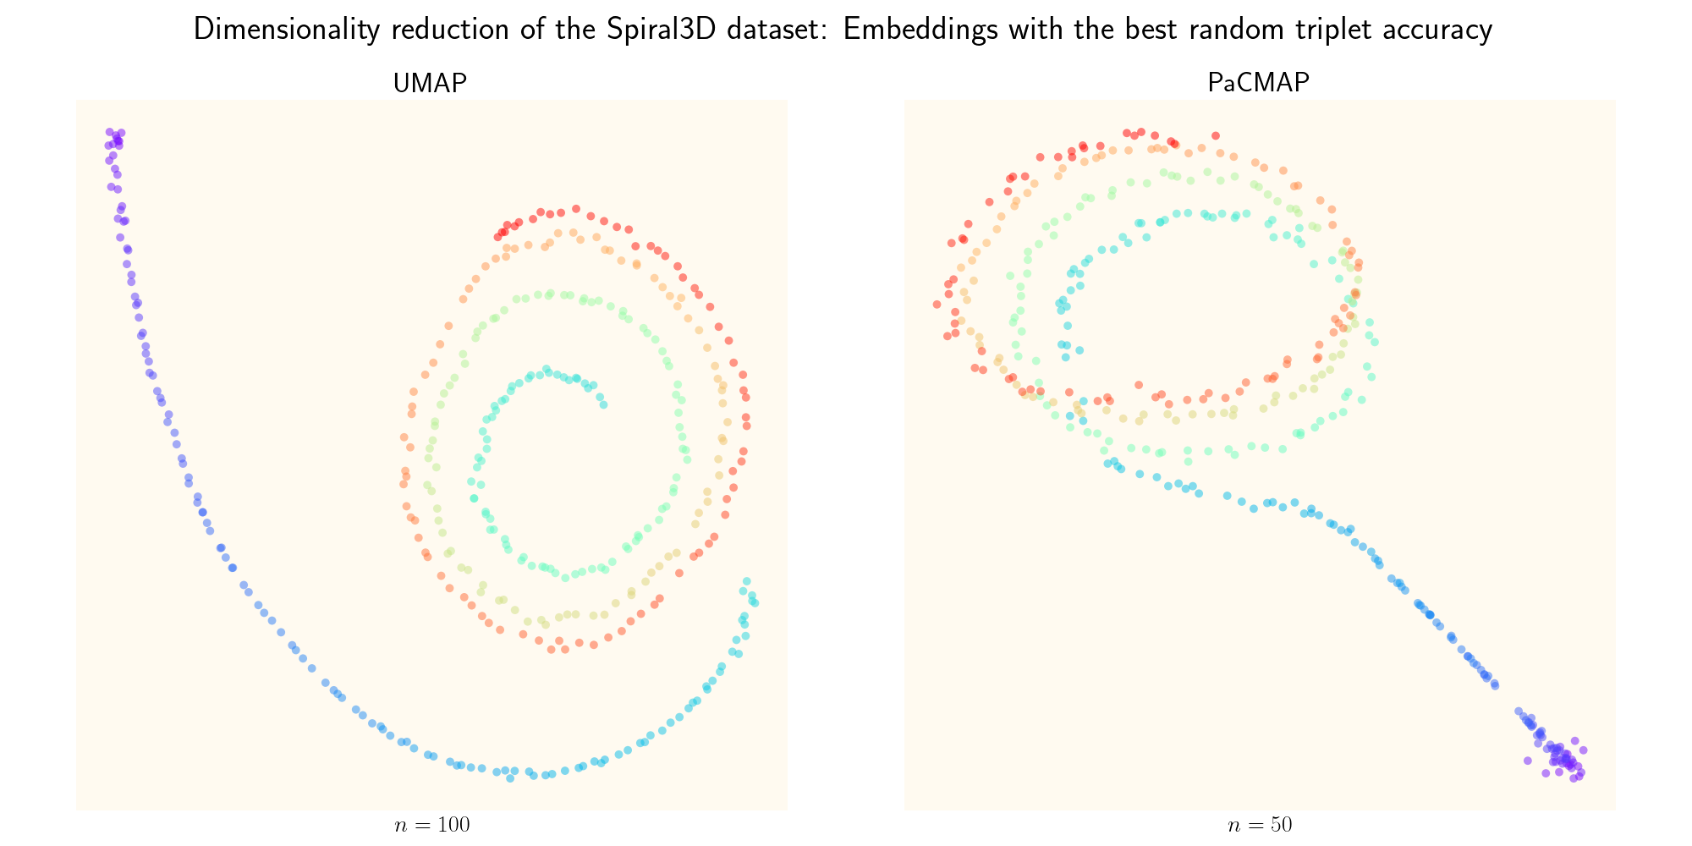
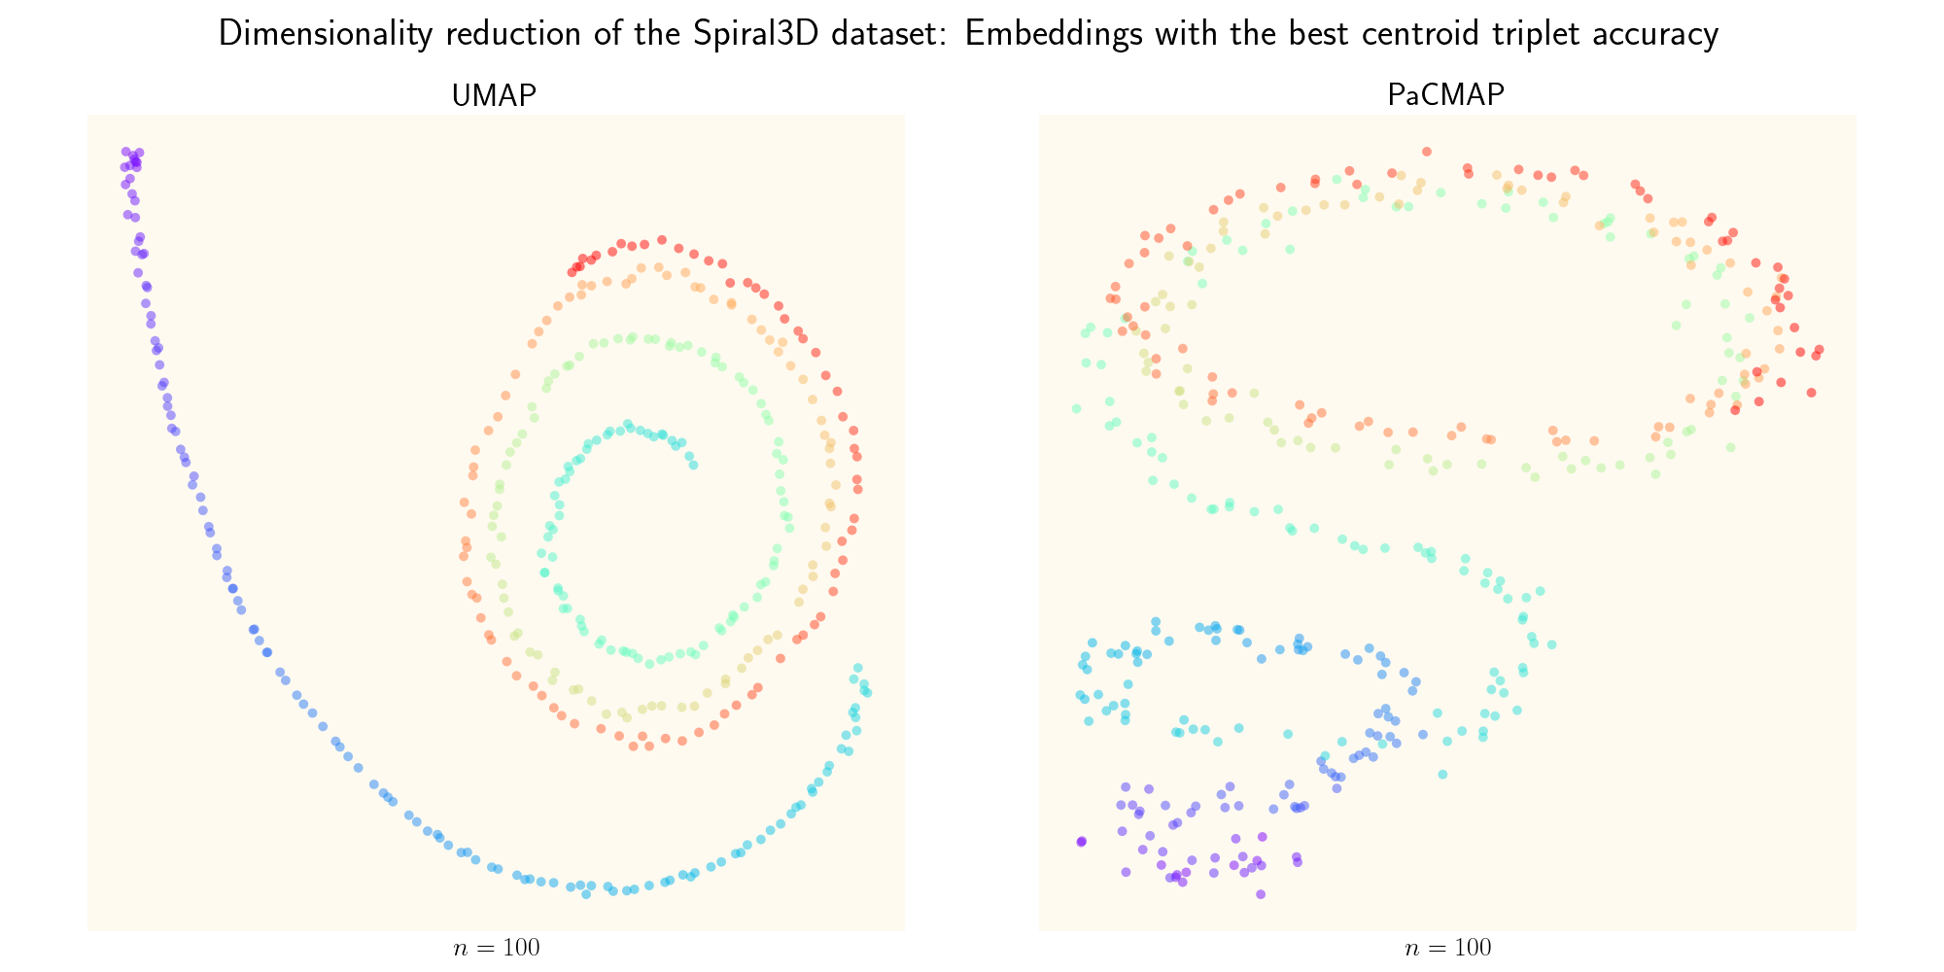
III. Evaluation
Spiral3D dataset: Global preservation
0.543
0.540
0.871
0.859

Slide 36
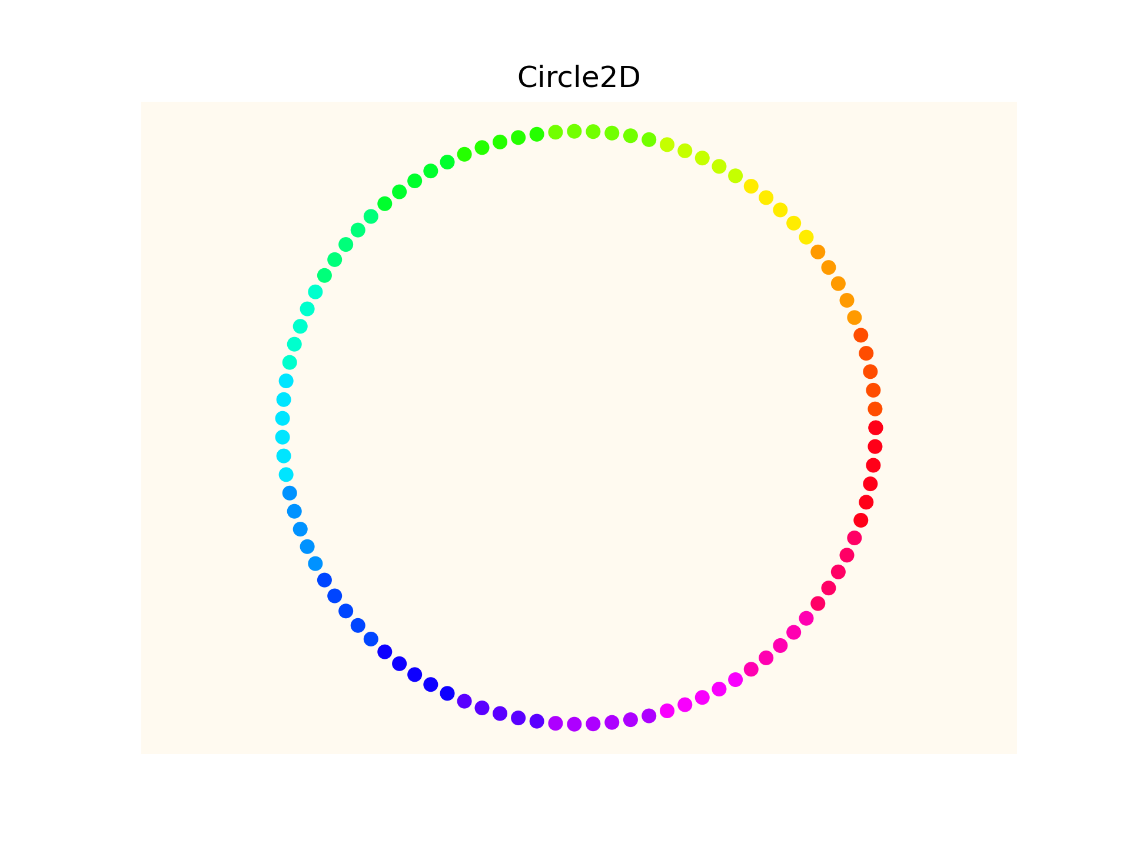
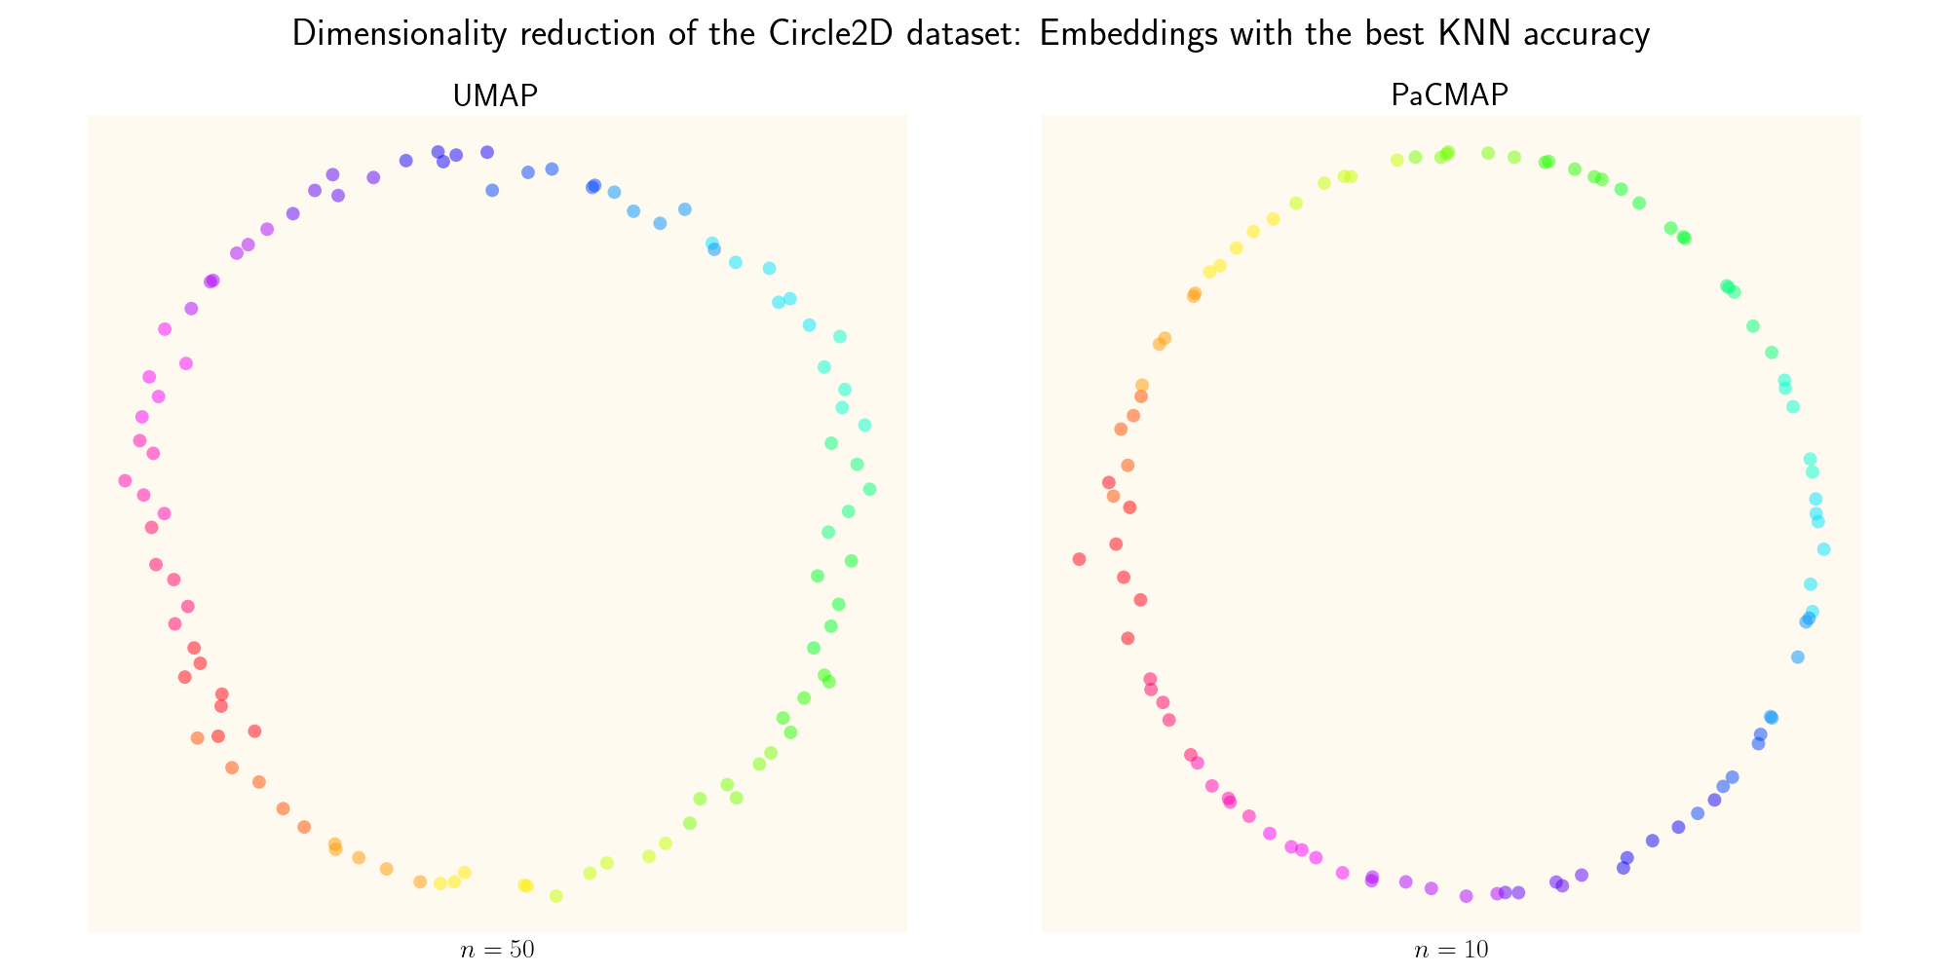
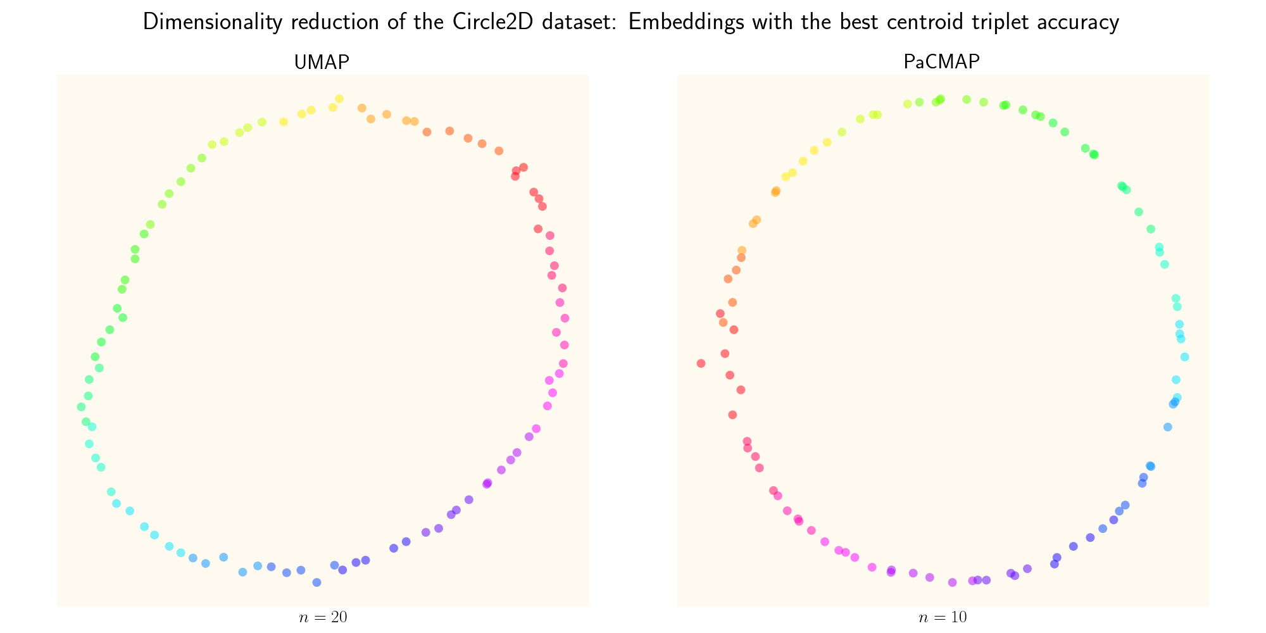
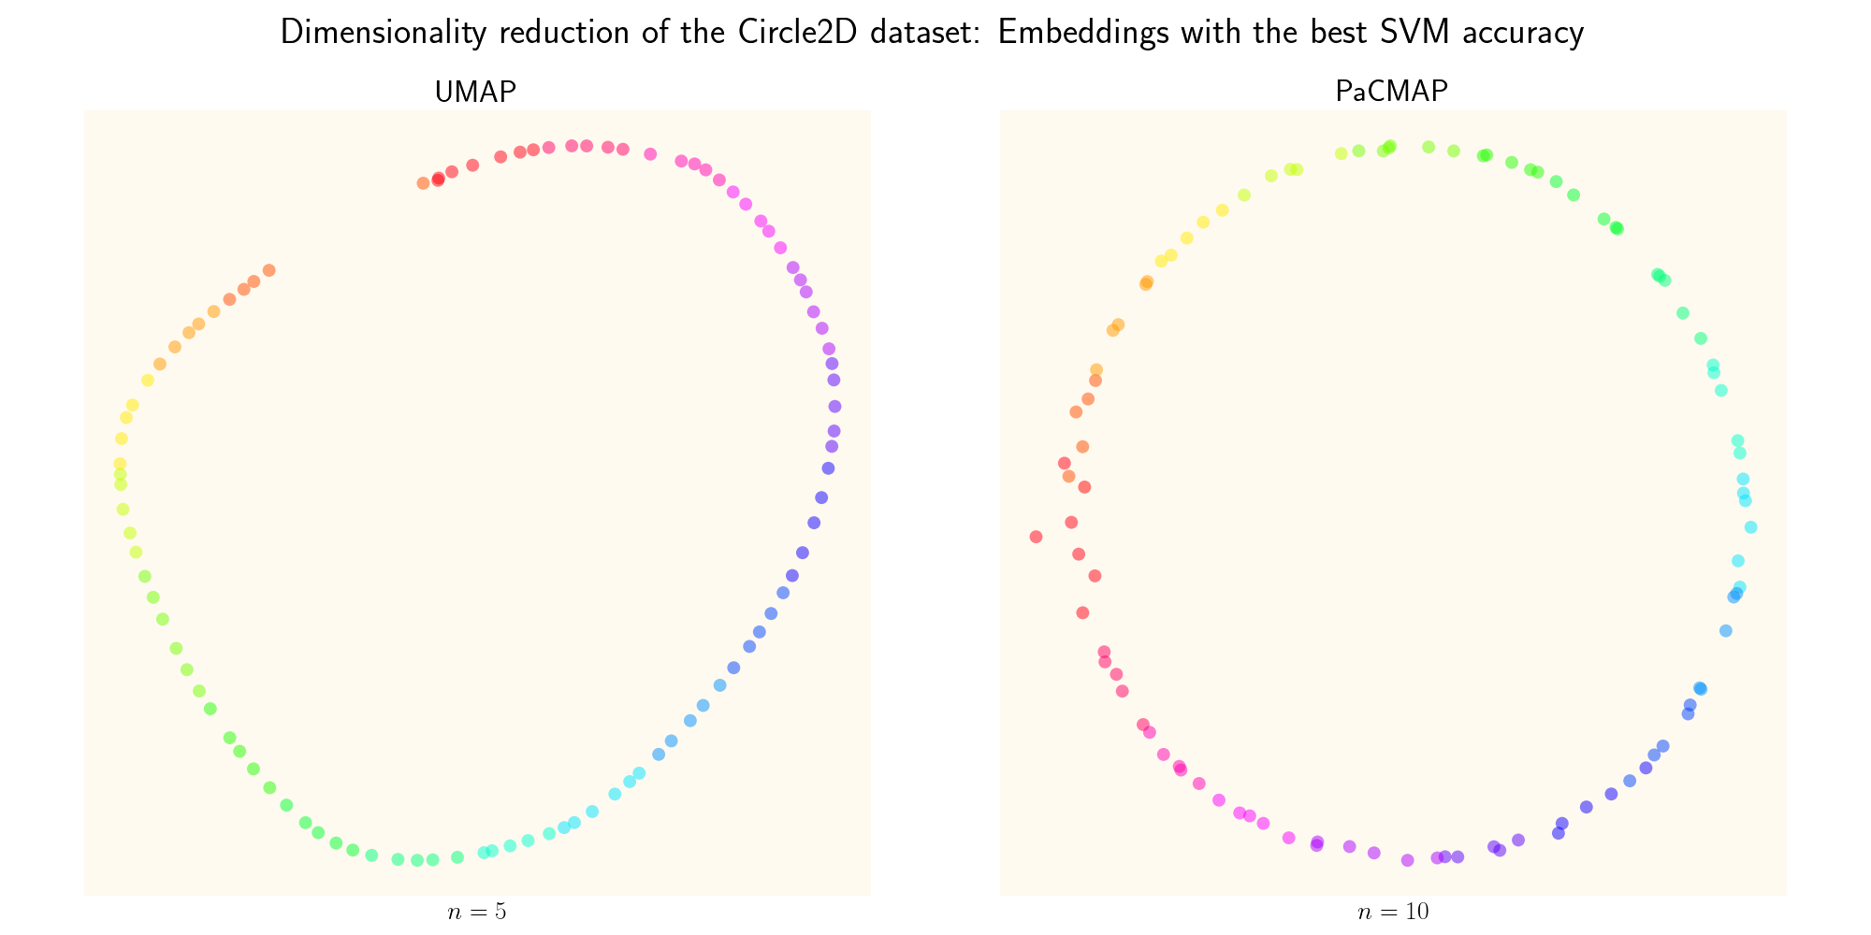
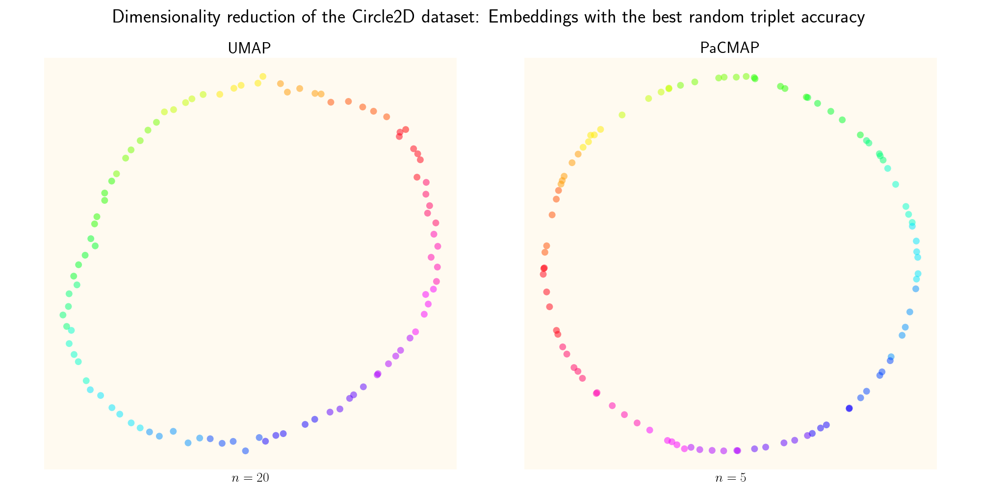
III. Evaluation
Circle2D dataset
0.830
0.800
0.800
0.770
0.950
0.990
0.926
0.968

Slide 37
Conclusion
How does the performance of UMAP compare to PaCMAP in local and global structures?
The evaluation will be based on KNN accuracy and SVM accuracy for local structure preservation,
and random triplet accuracy and centroid triplet accuracy for global structure preservation.
In my study, the algorithms generally perform equally well, except for random triplet accuracy where PaCMAP was better
However, the method would need to be refined → Future work

Slide 38
Future work
More careful hyperparameter search
Coarse to fine search
Wider range (now I only perform coarse search in range 5-100)
Experiment with more hyperparameters
Initialization
Number of optimization epochs
Mid-near and further point ratio
Etc.
Due to randomness in algorithms and evaluation: Average several measurements to get the metric values
Now, I only use one random seed and measure once
…but it takes a long time to run big datasets, so that’s for another larger project
Experiments on a vast number of datasets of different sizes etc. to be able to generalize conclusions

Slide 39
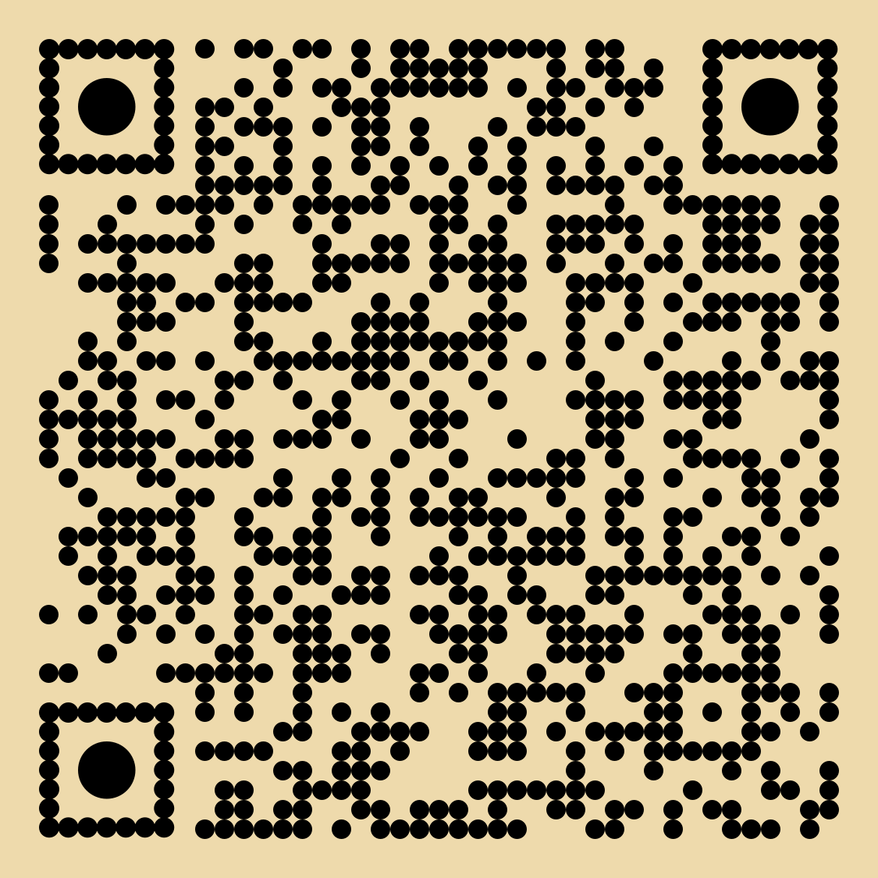
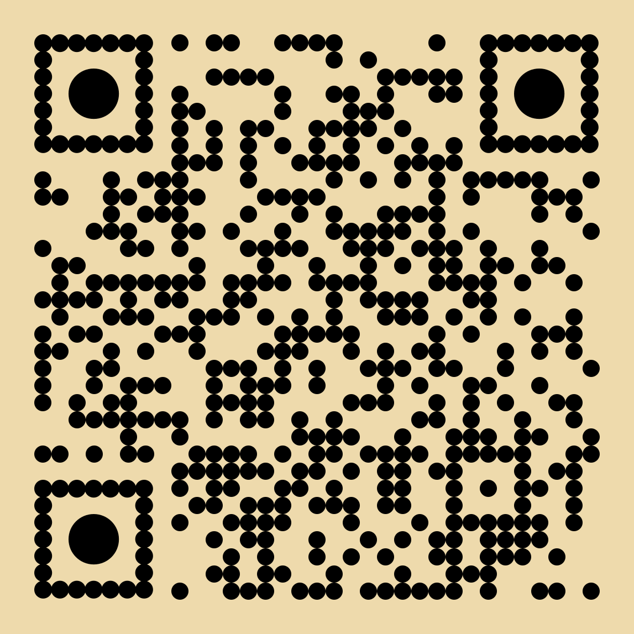
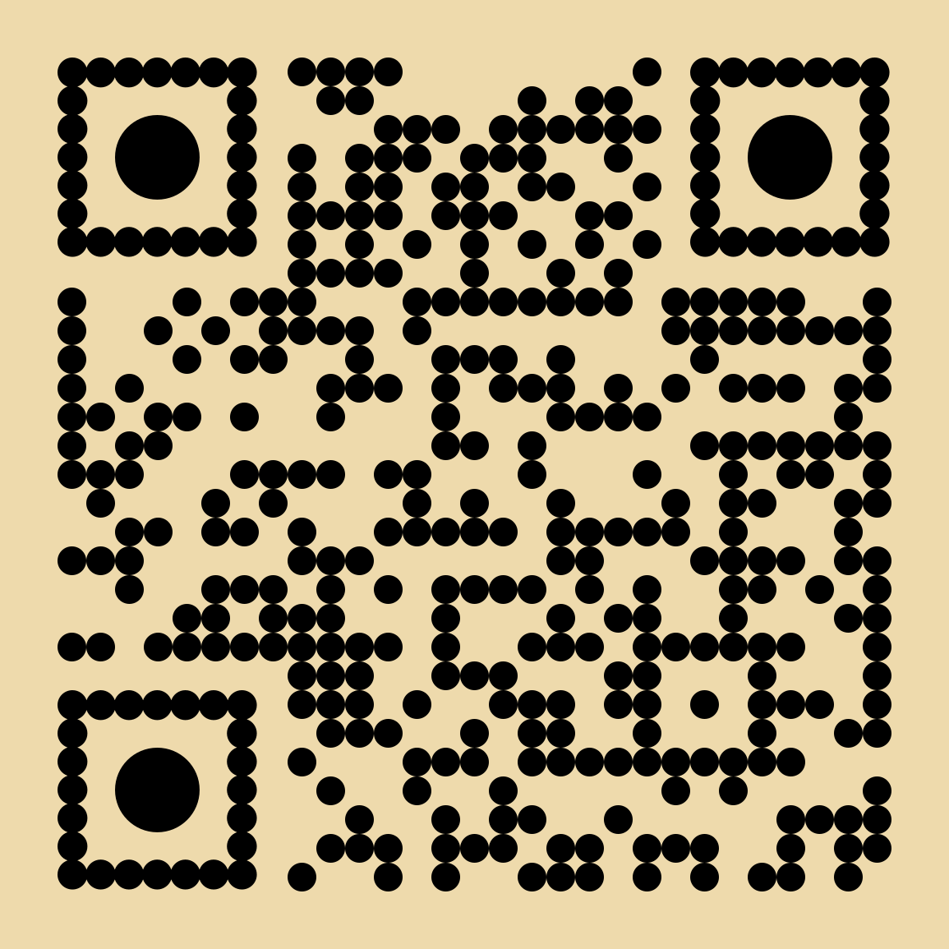

UMAP vs PaCMAP
Learn more about the project
Slides
GitHub repository
UMAP paper
PaCMAP paper
Linnéa Gustafsson, linneag2@kth.se
DD2470 Advanced Topics in Visualization and Computer Graphics
KTH Royal Institute of Technology

